Slide 1

Loan Status Eligibility Prediction Using Machine Learning
RISHI RAJ
(Analyst Task Report)

Slide 2

Problem Statement
The objective of this project is to develop a machine learning model to predict loan approval status based on applicant details and financial information.
The project involves preprocessing the data, performing exploratory data analysis, engineering features, selecting and evaluating classification models, and optimizing hyperparameters.
The deliverables include a detailed report of the entire process, the trained predictive model with performance metrics, and a deployable version of the model.

Slide 3
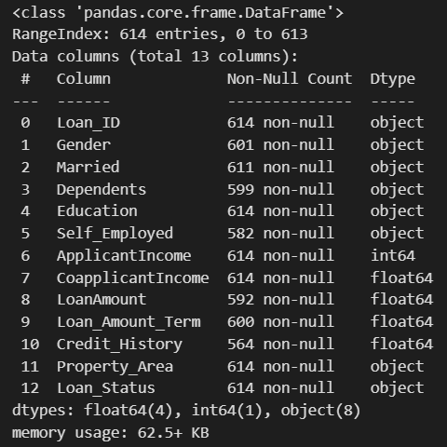
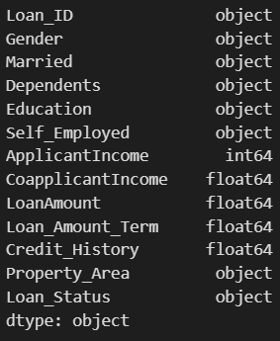
Column Details
About Datasets
1. Loan_ID : Unique Loan ID
2. Gender : Male/ Female
3. Married : Applicant married (Y/N)
4. Dependents : Number of dependents
5. Education : Applicant Education (Graduate/ Under Graduate)
6. Self_Employed : Self employed (Y/N)
7. ApplicantIncome : Applicant income
8. CoapplicantIncome : Coapplicant income
9. LoanAmount : Loan amount in thousands of dollars
10. Loan_Amount_Term : Term of loan in months
11. Credit_History : Credit history meets guidelines yes or no
12. Property_Area : Urban/ Semi Urban/ Rural
13. Loan_Status : Loan approved (Y/N) this is the target variable
data.info()
data.dtypes

Slide 4

Workflow Overview
Data Reading
Data Exploration
Data Visualization and Analysis
Data Preparation and Data Scaling
Train Test Split of Data
Model Training
Model Prediction and Accuracy Metrics
Building a GUI Application

Slide 5
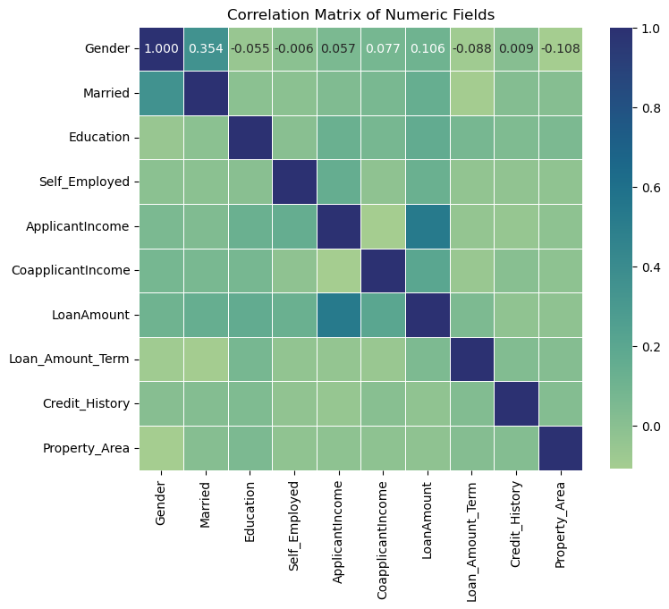
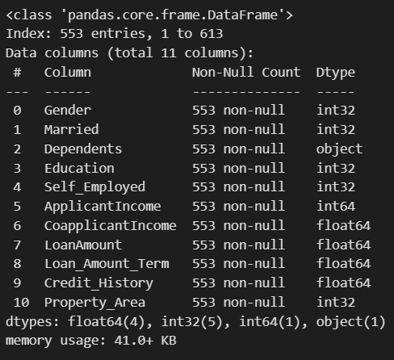
Read Data and Analyse
Dataset Info
Correlation Matrix of Dataset Fields

Slide 6

Data Exploration and Correction
Important Steps:-
Checking Data Types of columns.
Checking for null values.
Correlation among data.
Getting descriptive statistics of the data.
Removing some negative values

Slide 7
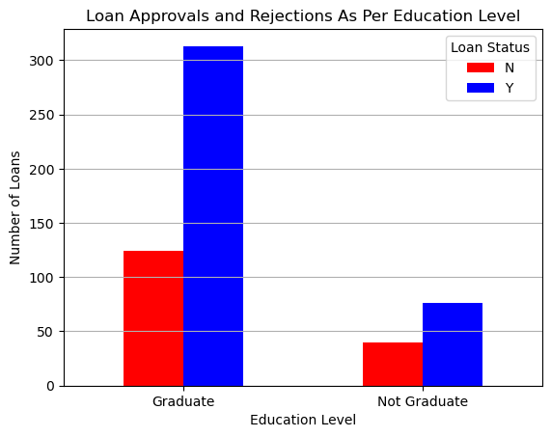
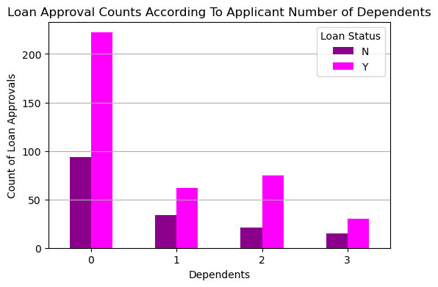
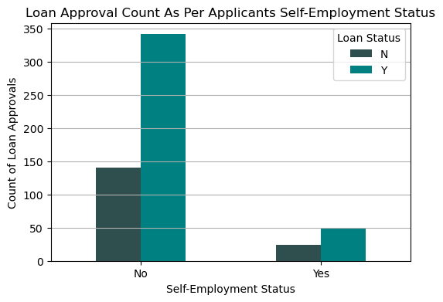
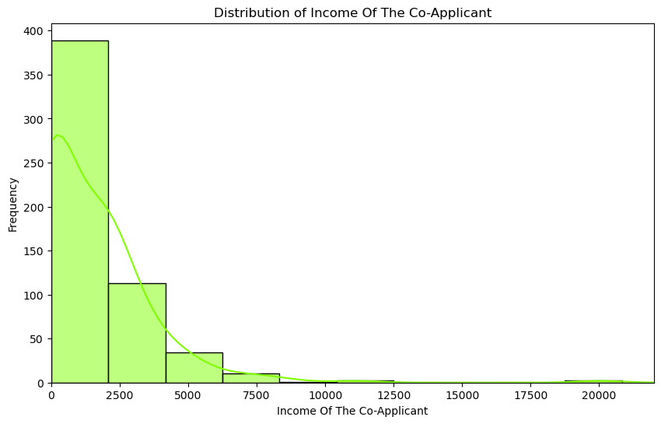
Data Analysis: Plotting and Charting

Slide 8
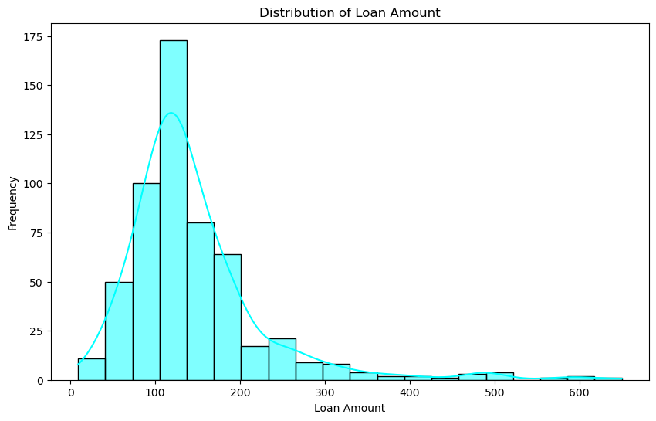
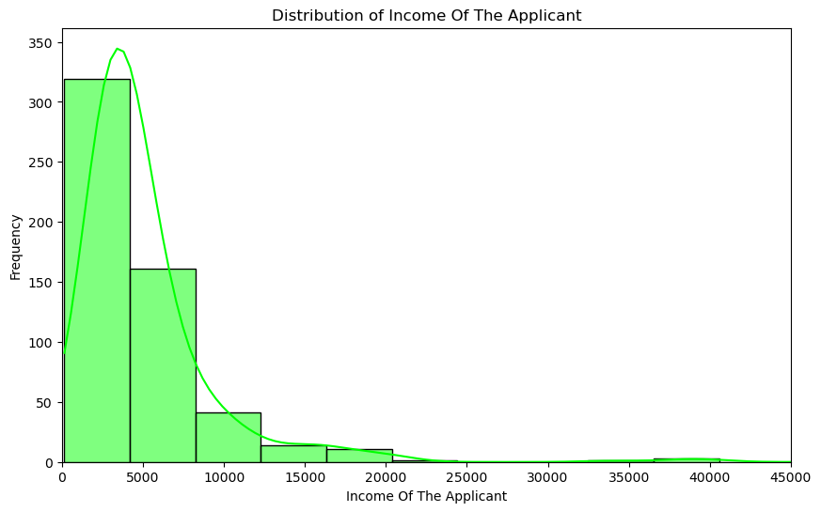
Data Analysis: Plotting and Charting

Slide 9
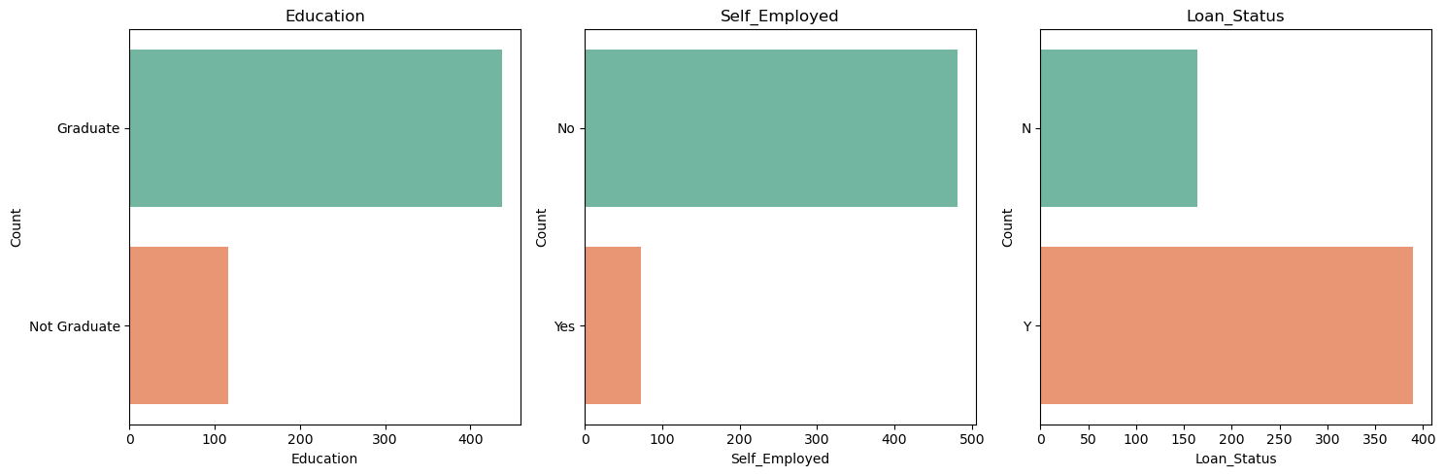
Data Analysis: Plotting and Charting

Slide 10
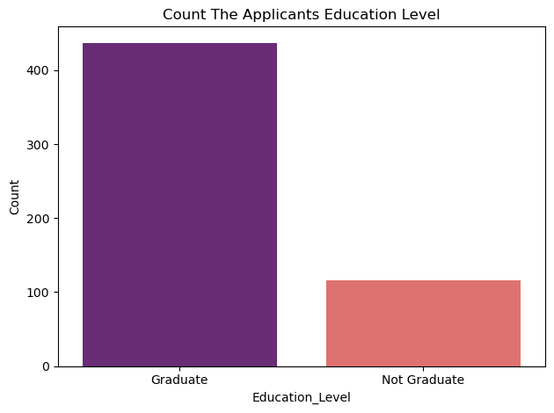
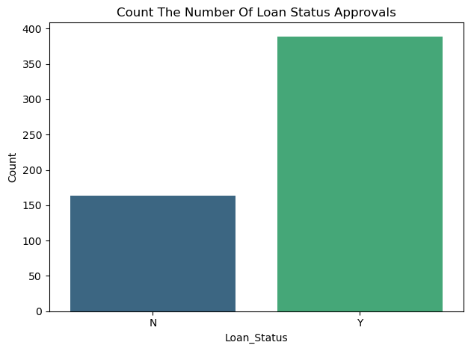
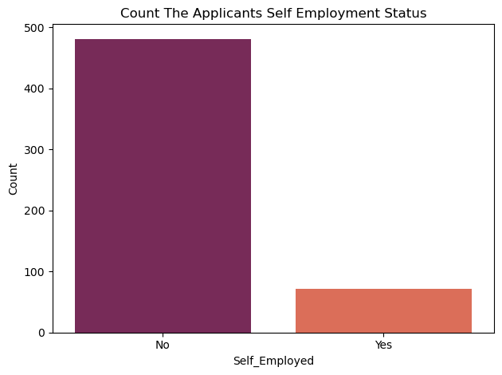
Data Analysis: Plotting and Charting

Slide 11
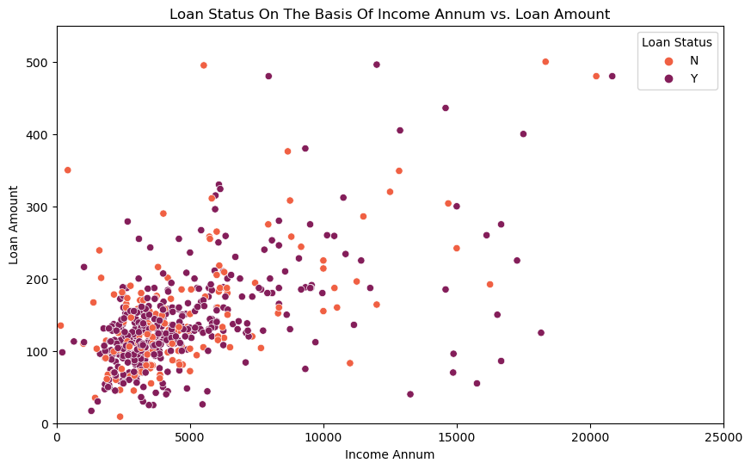
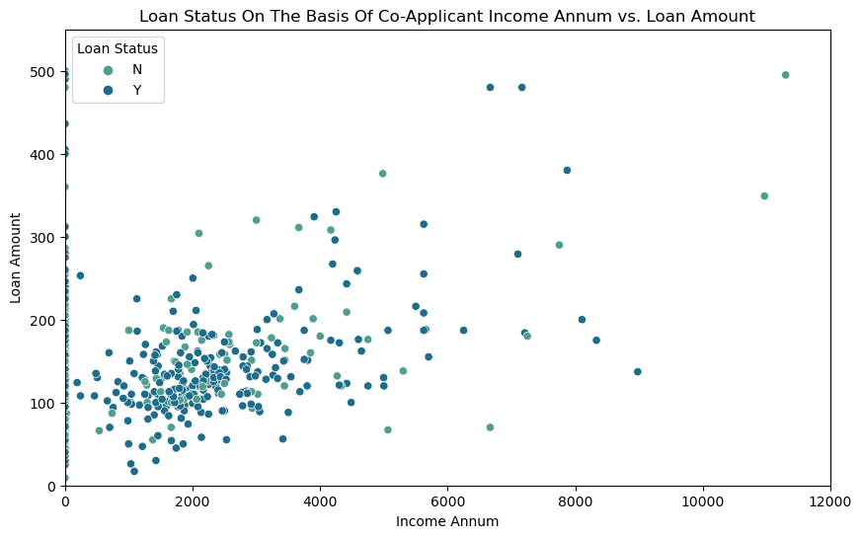
Data Analysis: Plotting and Charting

Slide 12
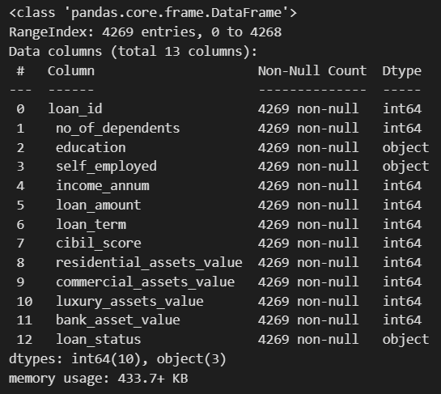
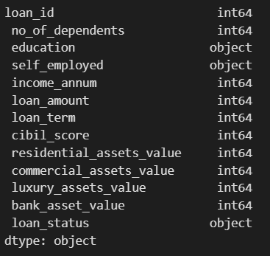
Column Details
For CIBIL Data
About Datasets
1. Loan_ID : Unique Loan ID
2. Dependents : Number of dependents
3. Education : Applicant Education (Graduate/ Under Graduate)
4. Self_Employed : Self employed (Y/N)
5. ApplicantIncome : Applicant income
6. LoanAmount : Loan amount in thousands of dollars
7. Loan_Amount_Term : Term of loan in months
8. Cibil_Score : Cibil Score
9. Residential_Assets_Value: Value Of Residential Assets
10. Commercial_Assets_Value: Value Of Commercial Assets
11. Luxury_Assets_Value: Value Of Luxury Assets
12. Bank_Asset_Value: Value Of Bank Assets
13. Loan_Status: Loan approved (Y/N) this is the target variable
data.info()
data.dtypes

Slide 13
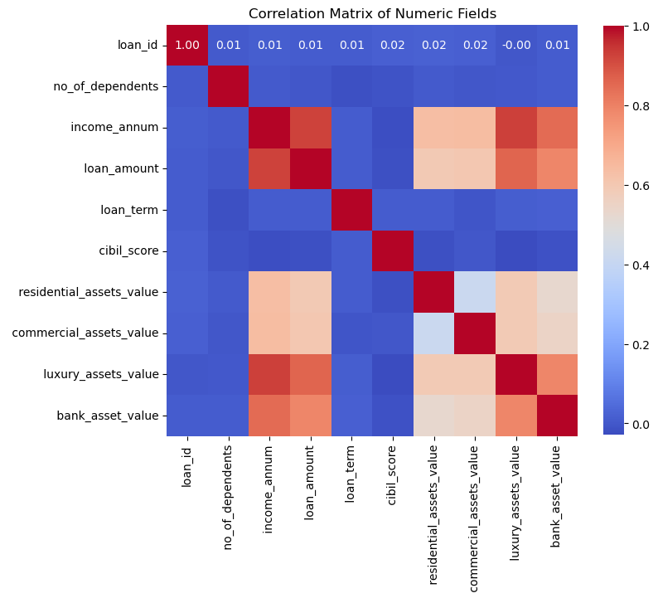
Read Data and Analyse
Dataset Info
Correlation Matrix of Dataset Fields

Slide 14
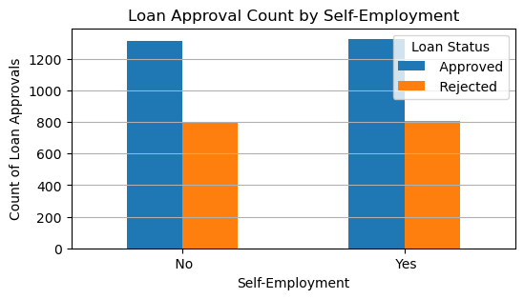
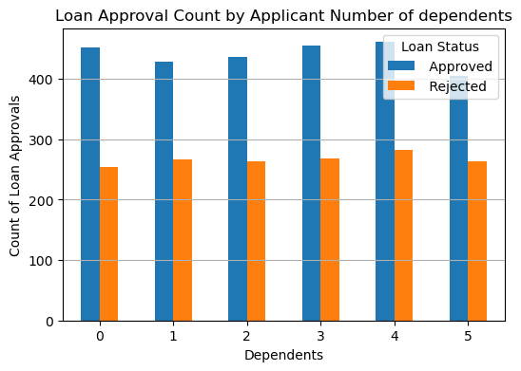
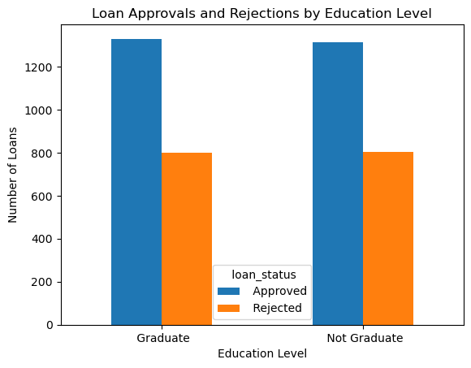
Data Analysis: Plotting and Charting

Slide 15
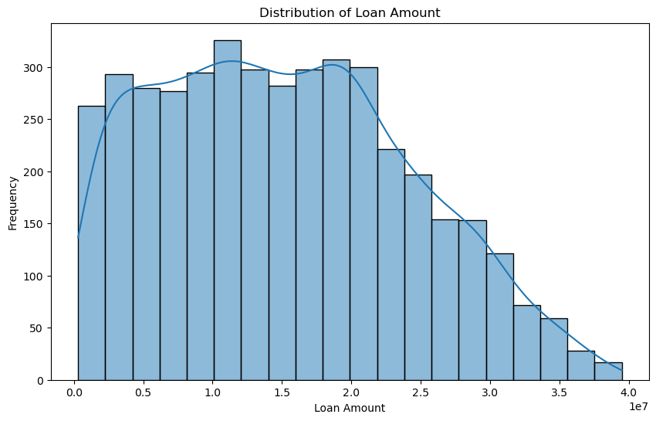
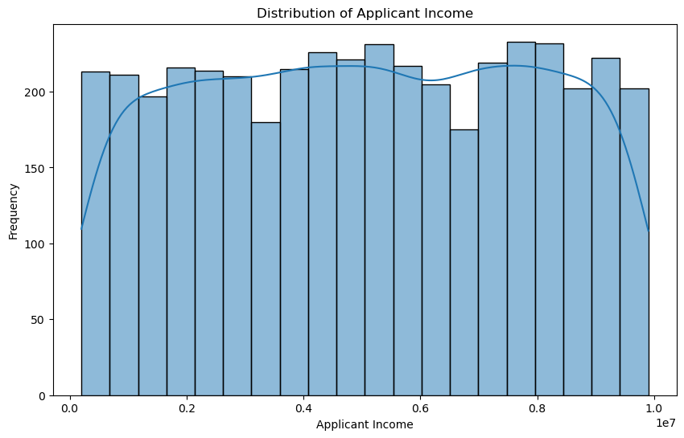
Data Analysis: Plotting and Charting

Slide 16
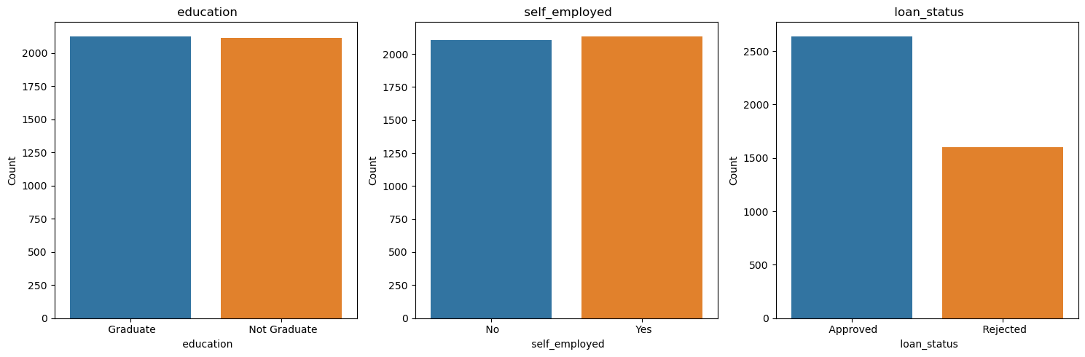
Data Analysis: Plotting and Charting

Slide 17
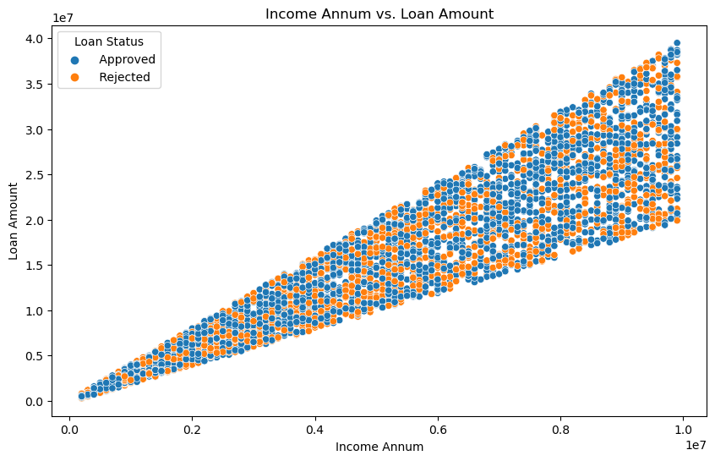
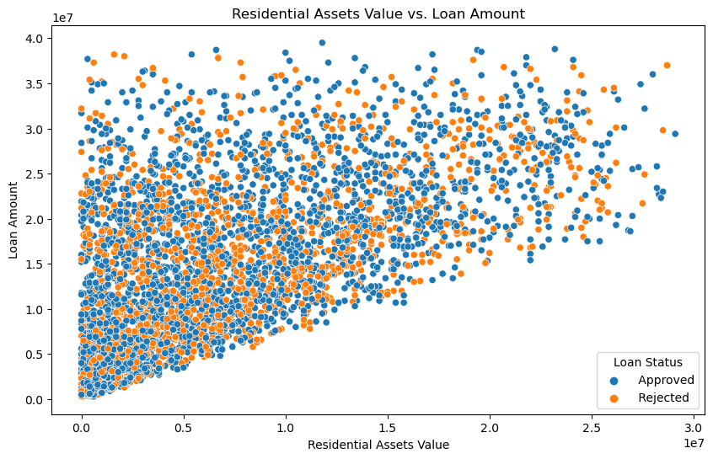
Data Analysis: Plotting and Charting

Slide 18
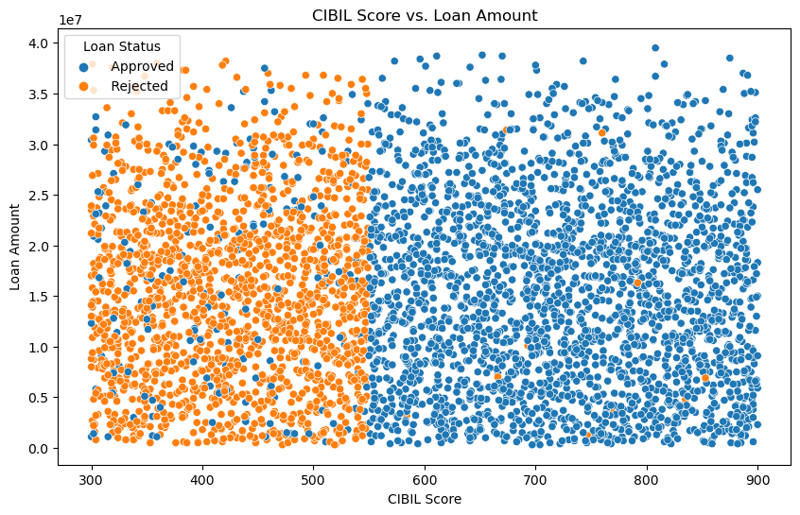
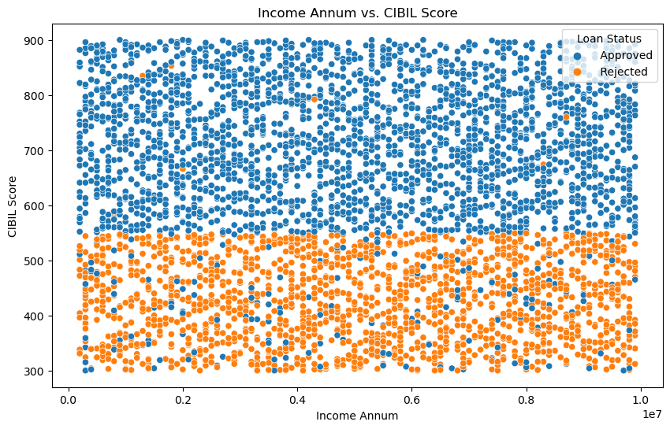
Data Analysis: Plotting and Charting

Slide 19
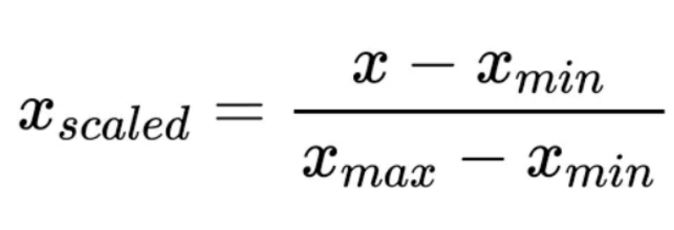
Convert Categorical Variables To Numeric
Categorical features refer to string data types and can be easily understood by human beings.
However, machines cannot interpret the categorical data directly. Therefore, the categorical data must be converted into numerical data for further processing.
We mapped categorical variables to numerical values for better processing by machine learning algorithms.
'Graduate': 1, 'Not Graduate’: 0
'Yes': 1, ' No': 0
'Approved': 1, 'Rejected': 0
Min-max Scaling
Min-max scaling, also known as normalization, is a technique commonly used in data preprocessing. It is used to transform numerical features into a specific range, typically between 0 and 1. However, machines cannot interpret the categorical data directly.
Many machine learning algorithms perform better when the input features are normalized. By scaling the features to a specific range, you can prevent any particular feature from dominating the learning process.

Slide 20
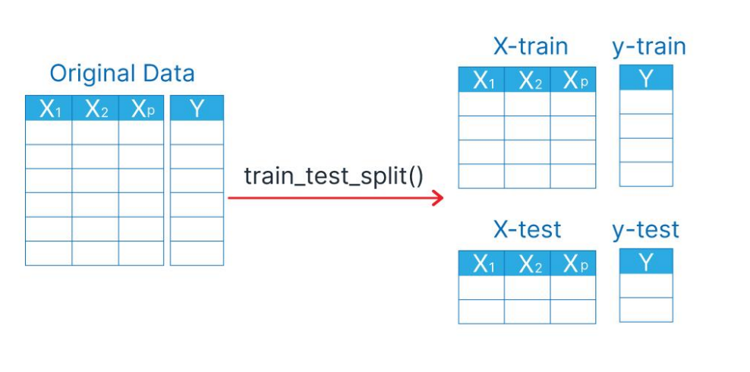
Data Preparation
Input : X
Output : Y
Supervised machine learning is a type of machine learning that learns the relationship between input and output. The inputs are known as features or X variables and output is generally referred to as the target or y variable. The type of data which contains both the features, and the target is known as labeled data.
Train Test Split :-
Train-test split divides the data once into distinct training and test sets used for model evaluation.

Slide 21
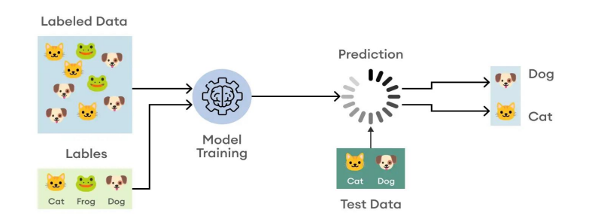
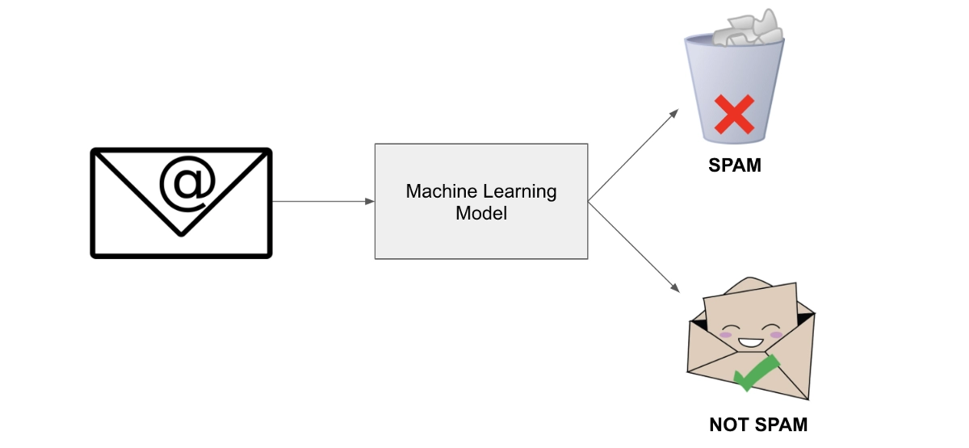
Machine Learning : Classification
Classification is a supervised machine learning method where the model tries to predict the correct label of a given input data.
In classification, the model is fully trained using the training data, and then it is evaluated on test data before being used to perform prediction on new unseen data.
Binary Classification:-
In a binary classification task, the goal is to classify the input data into two mutually exclusive categories.
The training data in such a situation is labeled in a binary format: true and false; positive and negative; O and 1; spam and not spam, etc. depending on the problem being tackled.
The loan approvals prediction is a binary classification problem.

Slide 22
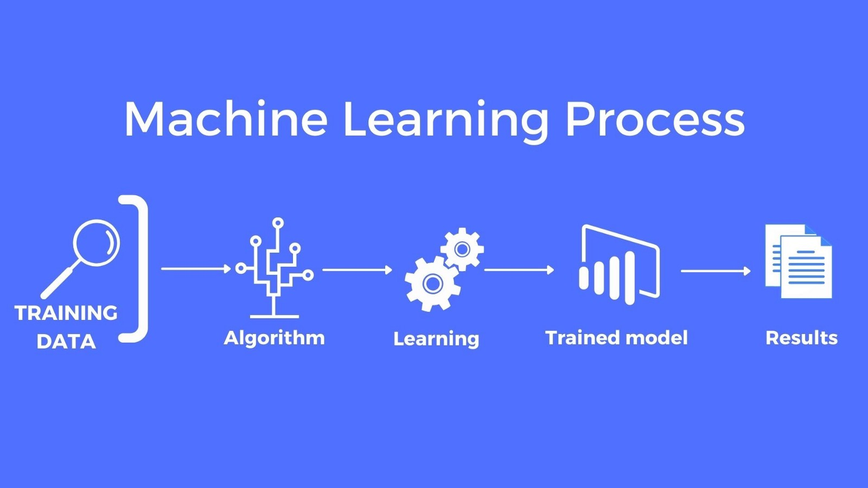
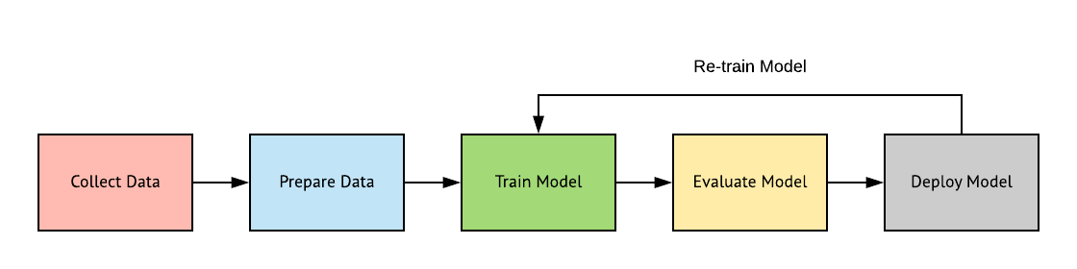
Model Training
A training model is a dataset that is used to train an ML algorithm.
It consists of the sample output data and the corresponding sets of input data that have an influence on the output.
The training model is used to run the input data through the algorithm to correlate the processed output against the sample output.
Models Used: Package-Sci-Kit Learn
Logistic Regression
Support Vector Machine (SVM)
Decision Tree Classifier
Random Forest Classifier
Gradient Boosting Classifier
Random Search CV

Slide 23
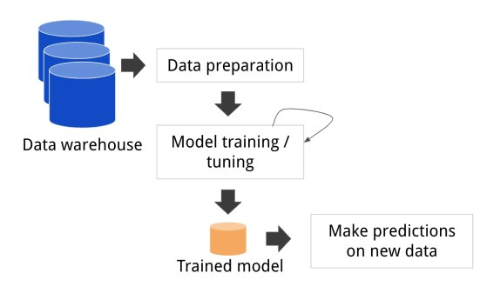
Model Prediction and Evaluation
Each input variable gets a label marking a category. In other words, the classification technique is used to map the input data to one of the categorial output labels.
Model Evaluation
Evaluating the performance of your classification model is crucial to ensure its accuracy and effectiveness.

Slide 24
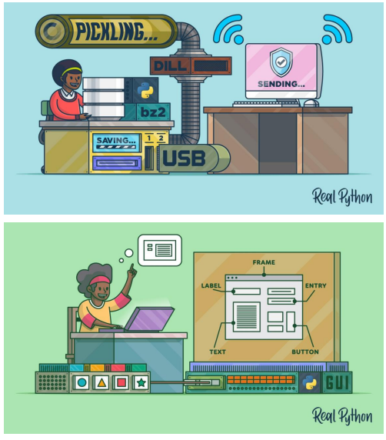
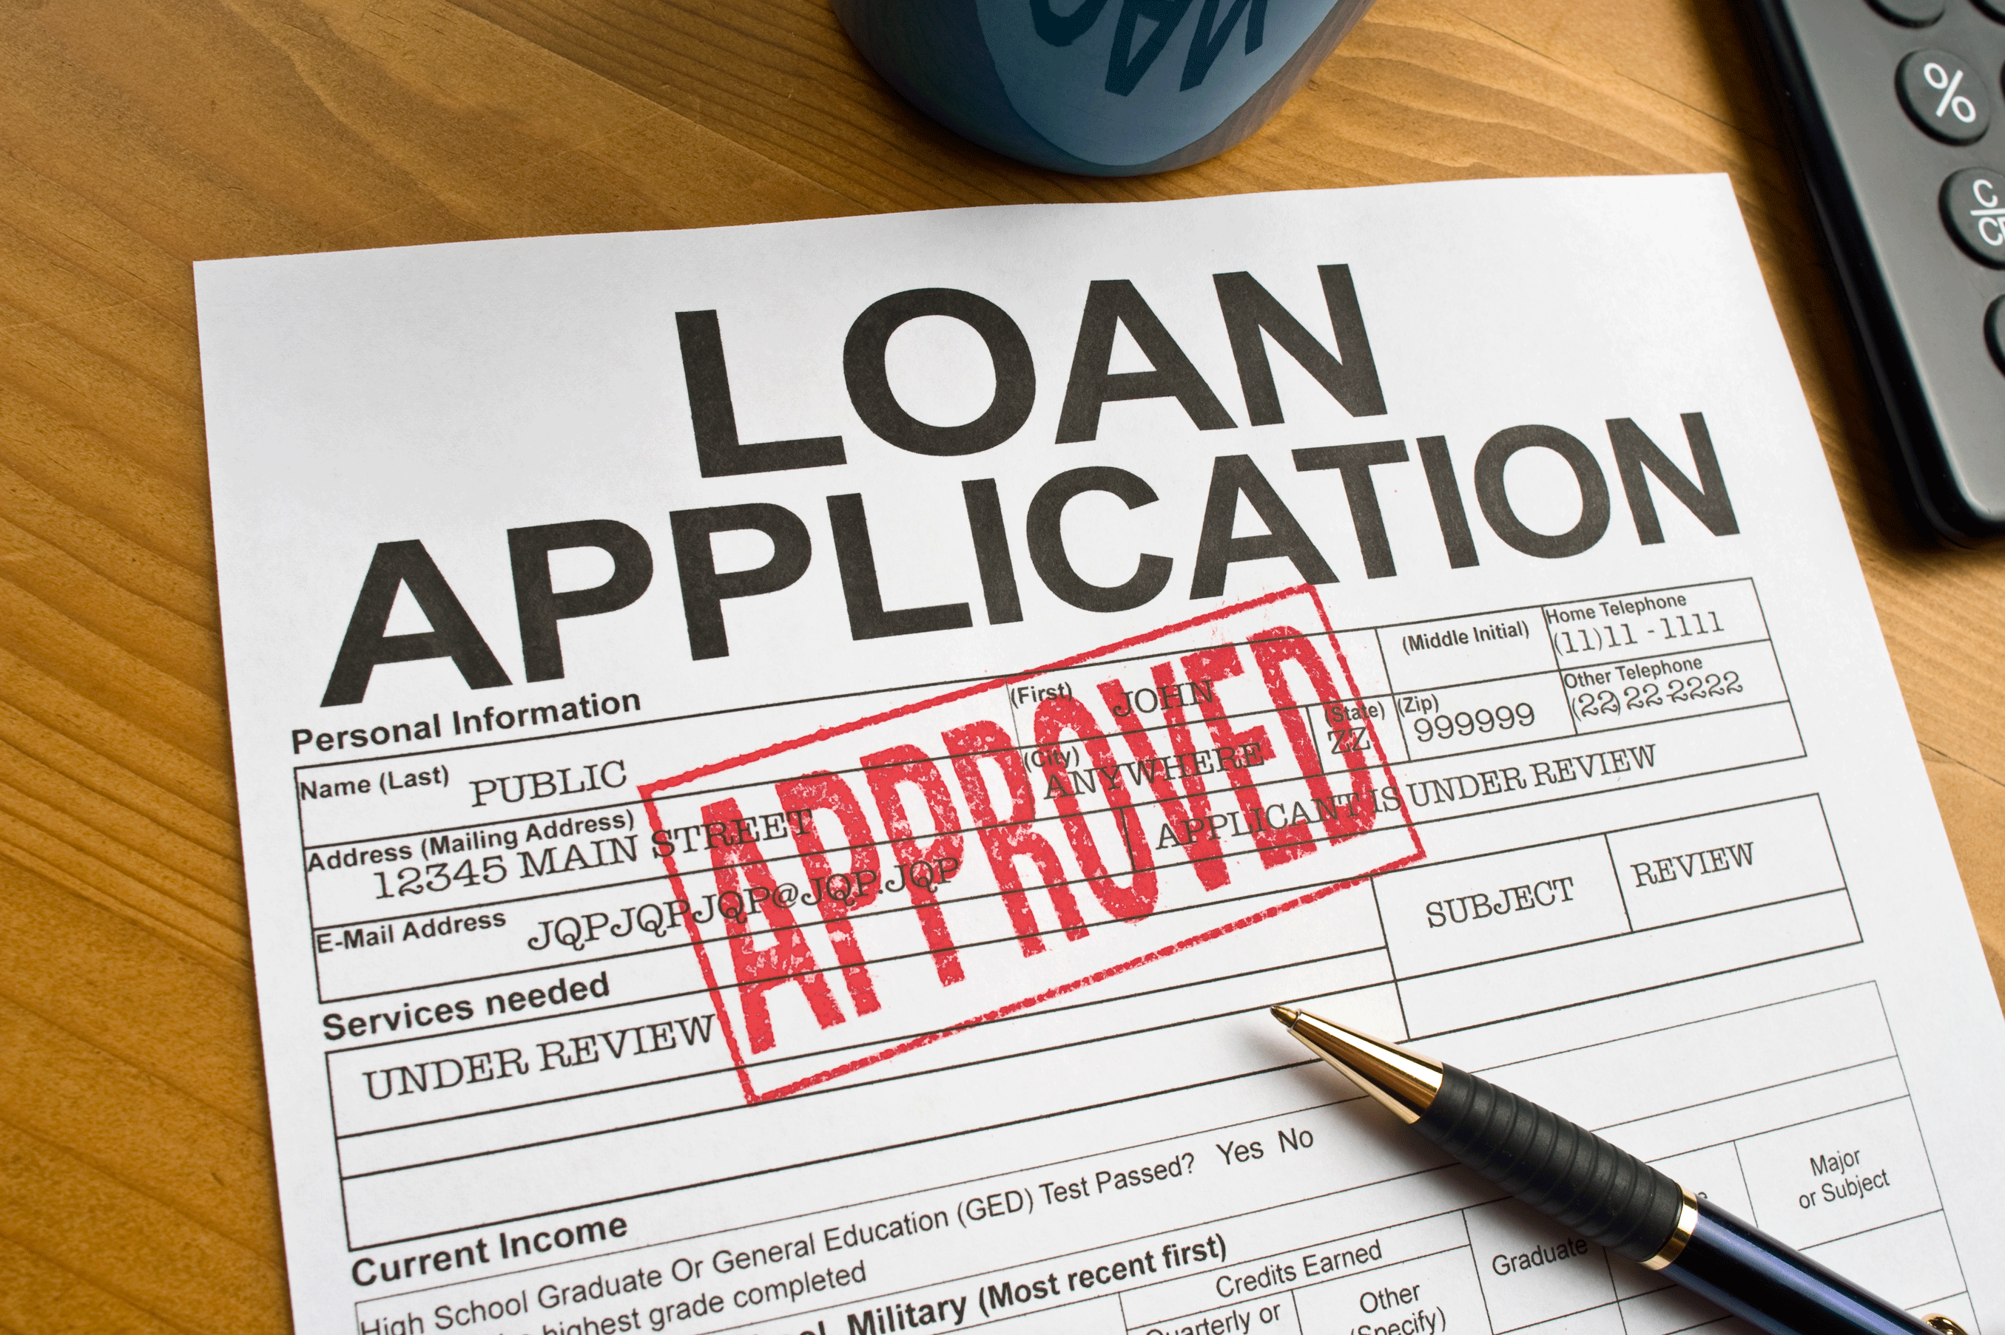
Building GUI Application
Saving the Model and Scaler.
Taking test Inputs.
Scaling the Inputs.
Passing the inputs to the model.
Getting the Output.
Displaying if Loan will be Approved or Rejected.
Building a GUI

Slide 25
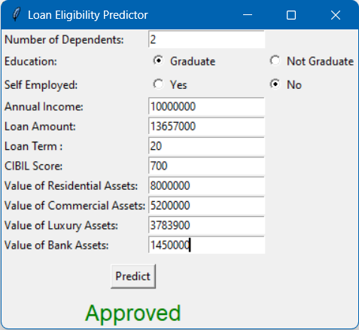
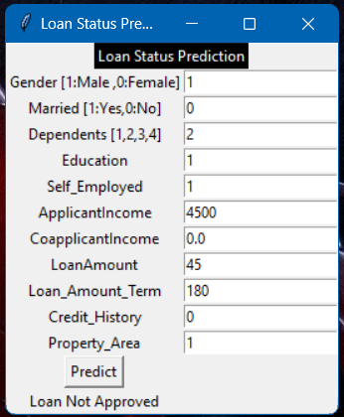
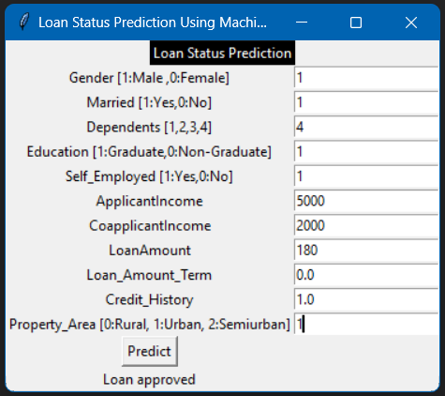
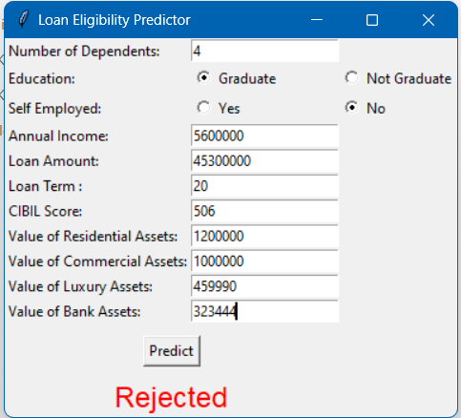
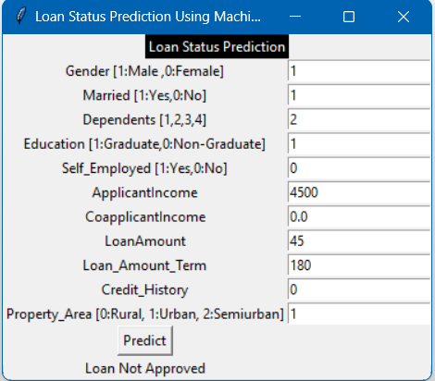
GUI Interface

Slide 26
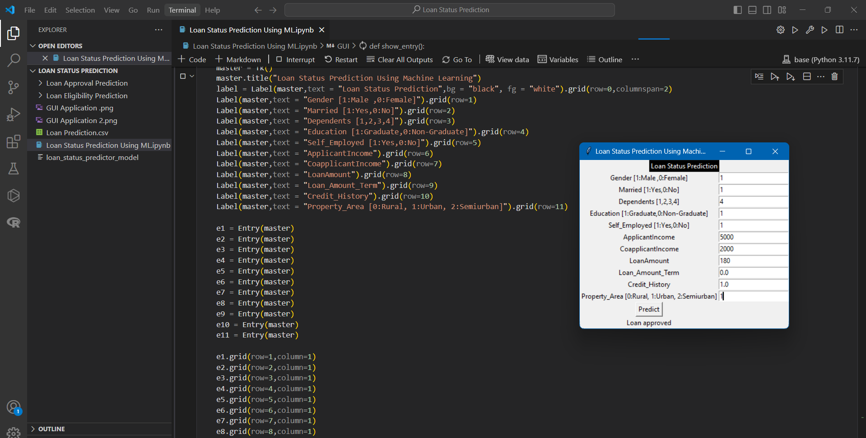
GUI Interface

Slide 27
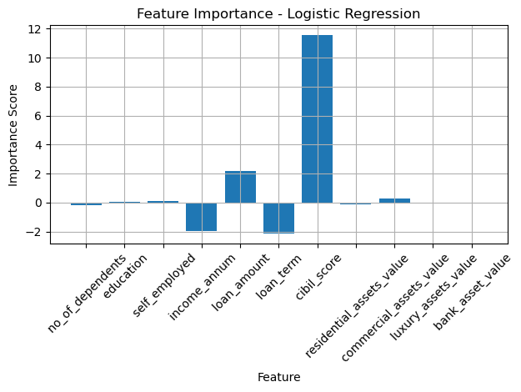
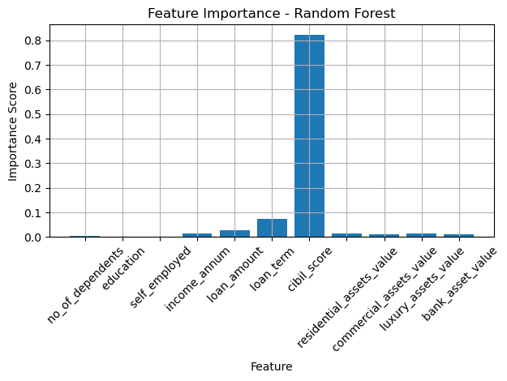

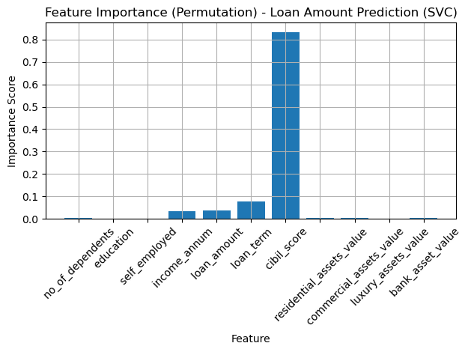
Feature Importance

Slide 28
Conclusion:-
The project involved assessing the performance of different machine learning models on a dataset. To improve the model, more data can be collected.
The models used were Decision Tree, Random Forest, Logistic Regression, and SVC.
Among the models examined, the Random Forest Classifier had the most accuracy in the project.
Based on current data, model can be built on 4-5 important features for future prospects.
The UI based application can be used by the bank to predict if a loan application should be approved or not.
Optimal hyper parameters can be found to improve the model.
With more data, Neural Networks can be used.
Feature importance refers to techniques that assign a score to input features based on how useful they are at predicting a target variable.

